Slide 1
Writing a literature review
CSW 2010
Stefano Pirandola
(Based on a 2009 lecture by Steve King
and a 2007 lecture by Helen Petrie)

Slide 2
What’s a lit review …
“A critical analysis of a segment of a published body of knowledge through summary, classification and comparison of prior research studies …[and previous] reviews …” (University of Wisconsin-Madison, 2006)
A lit review for a project is also focussed on providing the necessary background to your work, not a general survey of the area

Slide 3
Why is lit review important?
First reason: no-one is expecting you to make up the whole project, you should use as much as you can from previous work: ideas, methods, presentation style, critiques …
There should be a small number of relevant papers that you read over and over…
When you think, “how should I face problem X?”, look at these papers to understand possible approaches

Slide 4
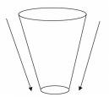
Why is lit review important?
Second reason: it provides the rationale for what you do in your project
Start from general considerations, build an argument which ends with your particular problem/topic

Slide 5
An example of lit review: lost in hyperspace
Suppose I’m interested in doing a project on why people get lost and confused on the Web
My first move for a lit review would probably be to do a search with Google Scholar (or using the ACM Digital Library, IEEE Xplore…)
Start thinking about terminology – what are the keywords related with this problem

Slide 6
An example of lit review: lost in hyperspace
It turns out that the key paper on the problem is called “Towards a practical measure of hypertext usability” and the keywords were: human-computer interaction, hypertext, usability
So it was quite tough to get this key paper
However, we also found another paper called “Lost in hyperspace: metrics and mental models” which led us to other important papers

Slide 7
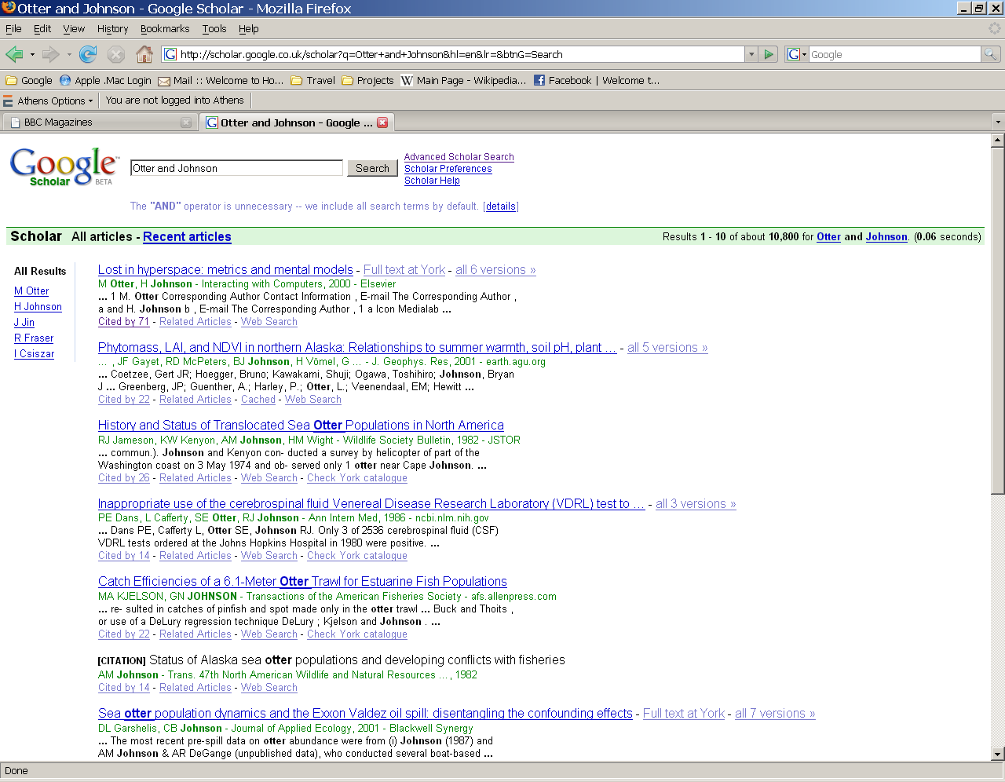
Following leads
Once you find a key paper, you can work forward by finding who cites that paper
Google Scholar and CiteSeer are very good for this
Enter the details of your key paper and then follow the “Cited by” link
This enables you to find more recent papers on the subject

Slide 8
Developing an argument
Once you have all these papers you need to consider specific contribution that each paper brings to your argument
In reading the papers you might learn all kinds of things, but remember that you are setting out the steps of the rationale underlying your work

Slide 9
Example of building the argument
Problem: how can I measure “lostness”?
Let us see how the argument is built in a paper by Gwizdka and Spence (2007)
G&S start their paper with this sentence: “Navigating large, complex websites is often difficult.”
Excellent start - general statement of the problem and clearly stated
This is just the top of the funnel!

Slide 10
Example of building the argument
Later in the paper G&S (2007):
“Getting lost, or disoriented, is known to be one of the most important problems in hypertext navigation, yet there have been but a few attempts to assess and quantify lostness.”
This is the argument the authors are developing – there’s not been much work on quantifying lostness - but we’ll tell you what has been done and what we think of it …

Slide 11
Summarize key points from previous papers
Later in the paper G&S (2007) introduce and summarize previous papers:
“Smith (1996) proposed an objective measure of lostness based on the ratios of visited and optimal node counts as shown in Equation 2. Larson and Czerwinski (1998) compared user performance on information search in three different hypertext hierarchies: [details of the three hierarchies]. Using Smith’s measure L&C showed that users were more lost on a hypertext with the 8x8x8 hierarchy than on either the 16x32 or the 32x16 hierarchies.”

Slide 12
Summarize key points from previous papers
So what is taken from Smith is the measure, whereas what is taken from L&C is the use of this measure to show that it worked
There is a problem with the text - not clear why L&C is building your argument until you get to the final sentence
Always try and lay the argument out to the reader very clearly. Lead your reader by the hand through your argument!

Slide 13
A re-write!
Smith (1996) proposed an objective measure of lostness based on the ratios of visited and optimal node counts as shown in Equation 2. Using this measure, Larson and Czerwinski (1998) compared user performance on information search in three different hypertext hierarchies: [details of the three hierarchies]. They found that users were more lost on a hypertext with the 8x8x8 hierarchy than on either the 16x32 or the 32x16 hierarchies. This provided a useful validation of the measure.”

Slide 14
Not only summarize but also classify
What are the research papers trying to do, or what do they do for your argument, what is their nature/contribution
“This provided a useful validation of the measure.”
In this way the paper of Larson and Czerwinski (1998) is correctly classified in the lit review of Gwizdka and Spence (2007)
Very important to make this explicit to the reader!

Slide 15
Summarize - Classify - Critique
This is hard and takes practice!
Are there important things that you think papers have not considered
  is the logic correct?
  was the method good?
Often the critique can come in the gaps between different papers (e.g., papers may consider different scenarios while you think that the most appropriate scenario is not treated anywhere…)
Also inconsistencies between papers are often very interesting - why are they inconsistent?

Slide 16
Continuing the review from G&S
“Otter and Johnson (2000) described two measures designed to assess user lostness. The first of their measures combines previous work by Smith (1996) with the effects of different types of links. Their second measure is concerned with the accuracy of users’ mental models of websites. The authors suggested that, to capture lostness in hypertext, a battery of measures was needed; Herder’s (2003) work supported this viewpoint. Ahuja and Webster (2001) conducted an experiment demonstrating that user perceived disorientation in web navigation

Slide 17
Continuing the review from G&S
(assessed by a questionnaire developed by the authors) is only weakly related to user behaviour, and that perceived disorientation is a better predictor of performance …. In a study that examined perceived user disorientation in hypermedia, Herder (2003) found that perceived disorientation (measured using the Ahuja and Webster instrument) was correlated with a combined page return rate (…) with median page view times, but not with the page revisitation ratio.”
Several problems here - switching terms hypertext – hypermedia
Difference between page return rate and page revisitation ratio not explained

Slide 18
Finally, the contribution from G&S:
“Thus, in contrast to Ahuja and Webster, Herder’s work demonstrated that user lostness was correlated with diverse measures of user behaviour. These findings suggest that lostness is not a simple unidimensional construct.”
So, they have been working up to showing slight inconsistencies between results from several of these papers (critique) and they finally propose their specific idea, i.e., user lostness is not a single construct.
We are now at the bottom of the funnel!

Slide 19
So, in conclusion
A lit review is really telling an interesting story about a particular issue/problem
It’s mainly about good, precise and focussed summarization of previous work
Classification/high level thinking about the previous work
Critique: negative or positive.

Slide 20
How to get started …
Carefully study a set of related papers
Bear in mind that in published papers, the lit review is very compressed - typically they might have 500 - 1000 words, you have around 2000.
That doesn’t mean you should waffle…
For Master students, all the details in the open assessment (available from 10 Nov. @ General Office)

